Slide 1

Microsoft AL
GUI & In-Client Designer

Slide 2



Prerequisite
Use Workshop-VM / Workshop-Computer follow the instructions of the Boarding Pass
Visual Studio Code
https://code.visualstudio.com
Competence Team DevTech
Microsoft AL

Slide 3
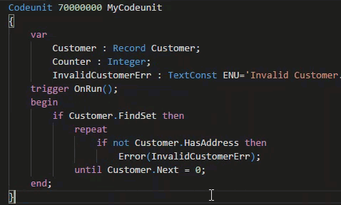
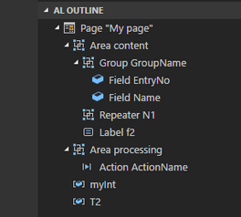
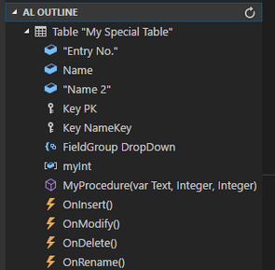
VS Code Useful Extensions
AL Formatter
Indentation
Keyword case style
Sort variable definitions
Readability Guidelines - Spacing and newlines (experimental)
AL Code Outline
Outlining – AL Object Structure
“Create List Page” from Table
“Create Card Page” from Table
al-util
“Rename & Move” Objects
Templates e.g. “Readme.md”

Slide 4
GUI & In-Client Designer Agenda
1
Language & Types
2
In-Client Designer
3
Hands On

Slide 5

Microsoft AL
Language & Types
Page
Page Extension
Page Customization

Slide 6
Microsoft AL Language & Types
Recommendation for VS Code
1 File per Object
Organize Object Files in Folders (Pages, PageExtension, …)
Use Snippets in AL
ttable
tpageext
tcodeunit
…
Documentation - Development in AL
https://docs.microsoft.com/.../developer/devenv-dev-overview
C/Side | Microsoft AL
 | Extending | New
Codeunit | - | codeunit
Table | tableextension | table
Page | pageextension pagecustomization | page
XMLport | - | xmlport
Query | - | query
Report | - | report
Menu Suite | - | -
 |  | profile
 |  | controladdin

Slide 7
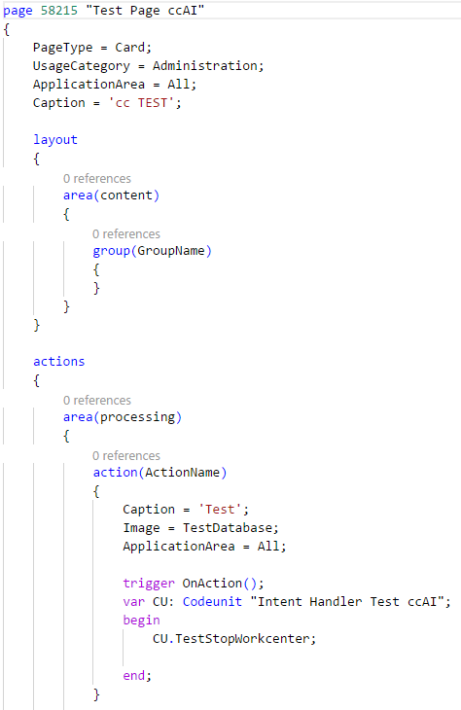
Microsoft AL Page
page <ID> „<Unique Name>“
Content Structure
Page Properties
Layout Section
Actions Section
Global Variables
Procedures & Events & Page-Triggers
Sections
Layout → Areas → Groups → Group-Properties & Fields → Field-Properties & Triggers
Action → Areas → Area-Properties & Actions → Action-Properties & Trigger

Slide 8
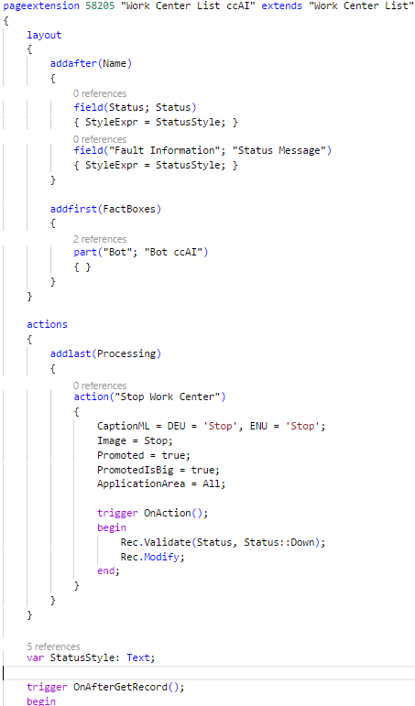
Microsoft AL Page Extension
pageextension <ID> “<Unique Name>” extends “< Target Page Name>” / or <ID>
Extensions / Modifications
Add addfirst(<ID>), addbefore(<ID>), addafter(<ID>), addlast(<ID>)
Move movefirst(<ID>), movebefore(<ID>), moveafter(<ID>), movelast(<ID>)
Modify modify(<ID>)
Changes in Sections
Layout → <Extension/Modification> → new / changed page content
Action → <Extension/Modification> → new / changed page actions
Additional Content
Global Variables
Procedures & Events & Page-Triggers

Slide 9
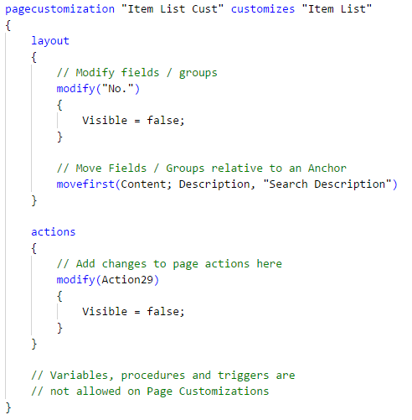
Microsoft AL Page Customization
pagecustomization “<Unique Name>” customizes “<Target Page Name>” / or <ID>
Modifications
Move movefirst(<ID>), movebefore(<ID>), moveafter(<ID>), movelast(<ID>)
Modify modify(<ID>)
Changes in Sections
Layout → <Modification> → changed page content
Action → <Modification> → changed page actions
No Additional Content!!!

Slide 10

In-Client Designer
WSIWYG Designer (Web Client)
Page Customization
Page Extension

Slide 11
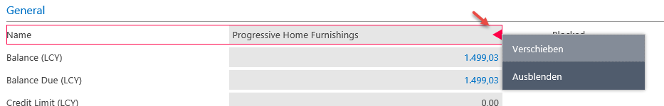
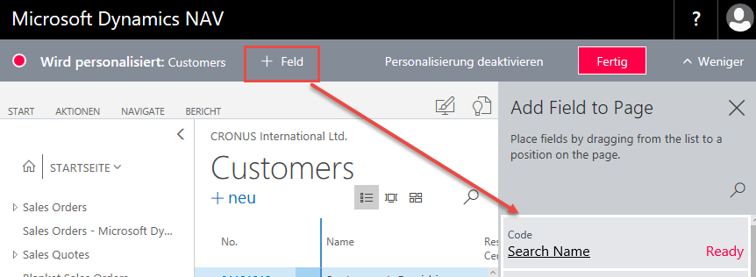
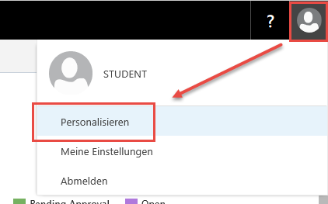

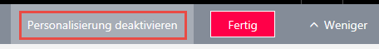
In-Client Designer Page Customization
Customization
Individual per User
On-Top of all modifications
User-Menu → Personalization
Actions
Show / Hide Fields
Move Fields

Slide 12
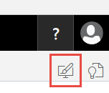
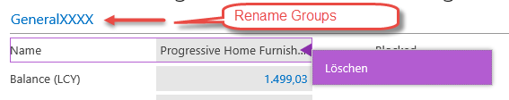
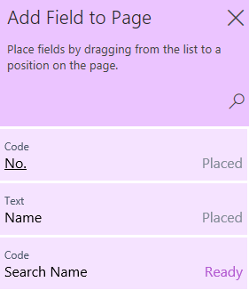
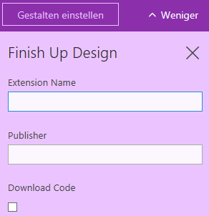
In-Client Designer Page Extension
Extension
For all Users
On-Top of all existing modifications except Customizations
Designer-Menu
Designer Actions
Rename Groups (e.g. Card Pages)
Add, Delete, Move Fields
Finish Up
Download Extension package (zip)

Slide 13
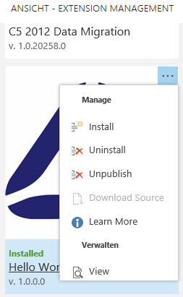
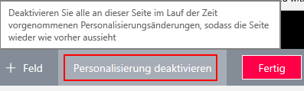
In-Client Designer Extension / Customization Management
Remove an Extension
Page “Extension Management”
Uninstall → “Deactivate”
Unpublish → Remove from System
Remove a Customization
Open Personalization → Deactivate the Personalization

Slide 14

It’s Lab Time
Hands On
In-Client Designer
In-Client Designer & VS Code

Slide 15
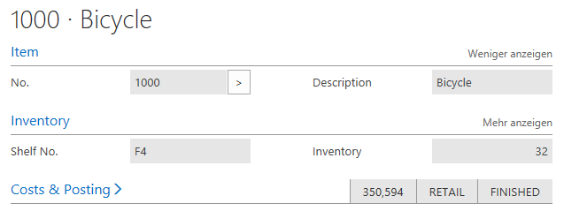
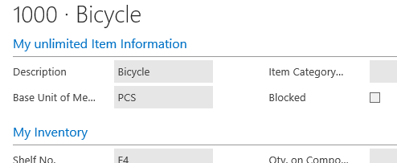
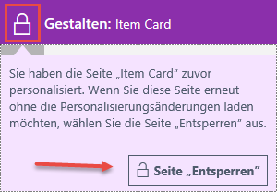
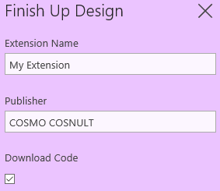
In-Client Designer Hands On
Open the Web Client
Personalize the „Item Card“
Hide some Fields
Rearrange some Fields
Save the Customization
Create an Extension for the Item Card
Unlock Designer when necessary
Rename the Item Group
Rearrange some Fields / Factboxes
Add Fields if you want
Finish the Extension and Download the Package

Slide 16
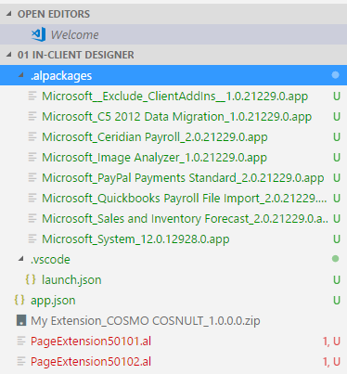
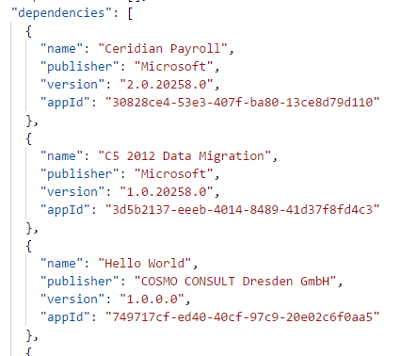
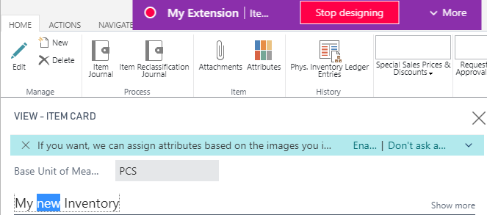
In-Client Designer Hands On
Unzip your Extension
Clean up the dependencies in app.json
Open in VS Code
Download Symbols [Ctrl] + [Shift] + P … “Downlaod Symbols”
Compile [Ctrl] + B
Publish [Ctrl] + F5
Run the Designer from VS Code
Check app.json "showMyCode": true
Start the Designer F6
Edit the Page “Item Card”
Rename the Group “InventoryGrp“
Save the changes
Download Source Code F7

Slide 17

Q & A
Visual Studio Code
https://code.visualstudio.com
Competence Team DevTech
Channel Microsoft AL

